Slide 1
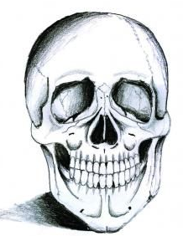

Looking at a CSS Framework - Skeleton

Slide 2
Some CSS Complexities
CSS – red
HTML - blue

Slide 3
Multiple Classes in CSS (1)
In CSS, what does this mean?
.class1, .class2, .class3{ color:red; }
The CSS styles all elements the same. They can be used separately.
<div class="class1">
</div>
<div class="class2">
</div>
……..
………

Slide 4
Multiple Classes in CSS (2)
In CSS, what does this mean?
.class1 .class2 .class3{ color:red; }
Select all elements with the class name class3 that are descendants of the classes – class2 and class1.
<div class="class1">
<div class="class2">
<div class="class3">
……..
………

Slide 5
Multiple Classes in CSS (3)
In CSS, what does this mean?
.class1.class2.class3{ color:red; }
Select the element which has class name of class1 and also class names of class2 and class3.
<div class="class1 class2 class3">
……..
………
Note: class3 will override class2 and class1

Slide 6
Skeleton Framework
(http://getskeleton.com/ )

Slide 7
Skeleton Framework
What does the Skeleton framework consist of?
  2 style sheets
  index.html
  Relevant images

Slide 8
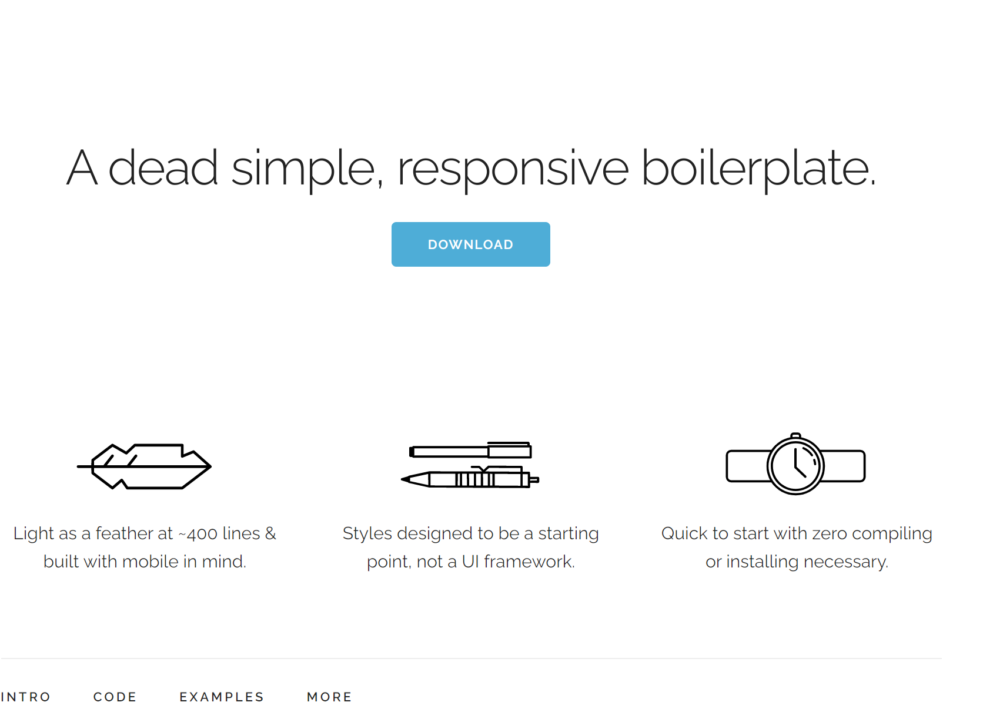
Skeleton Framework

Slide 9
3 Style Sheets
normalize.css
  Basic styles of Skeleton
Skeleton.css
  The Skeleton grid

Slide 10
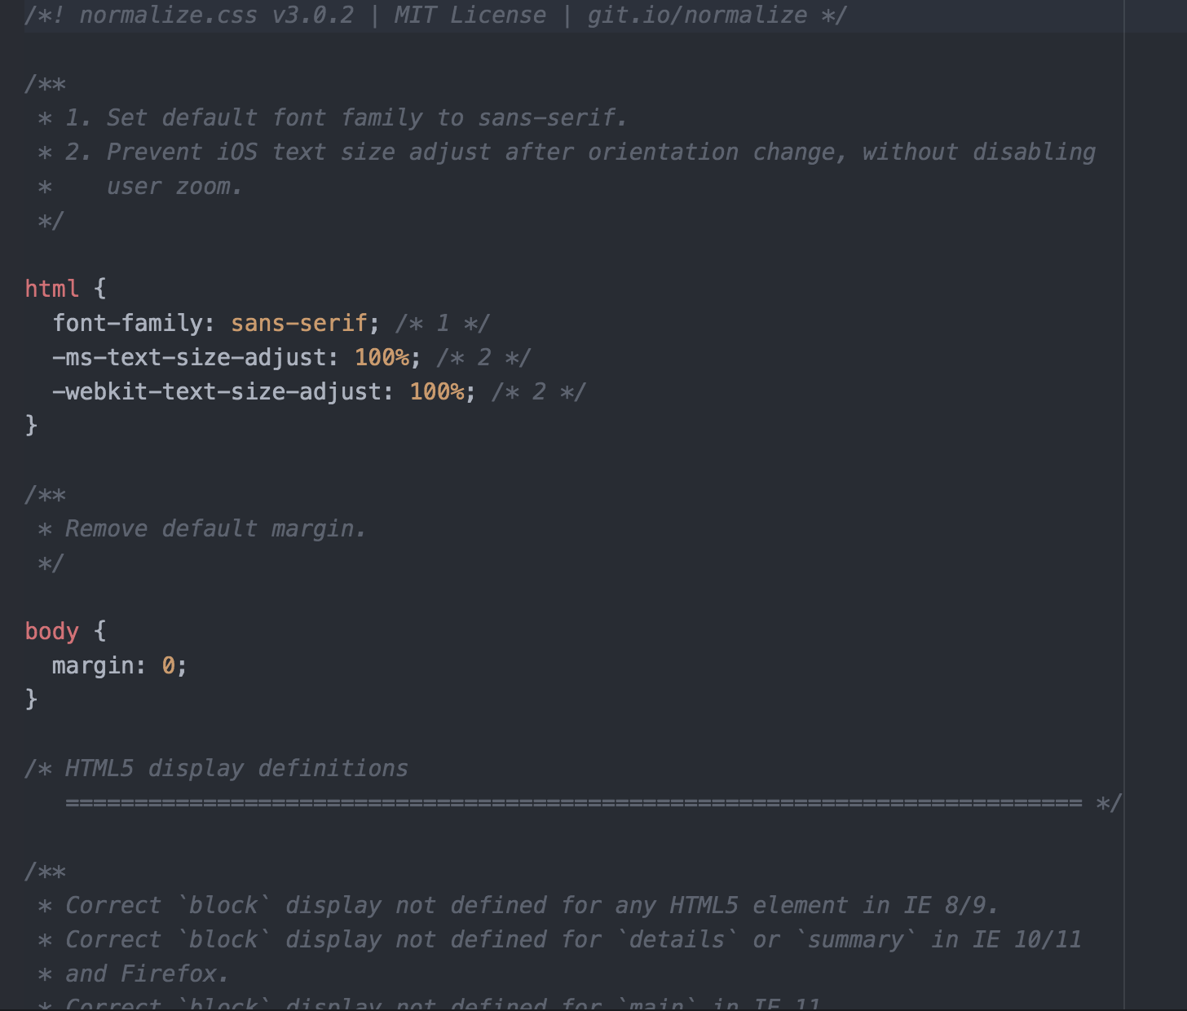
Sample of normalize.css
Styling of html tags

Slide 11
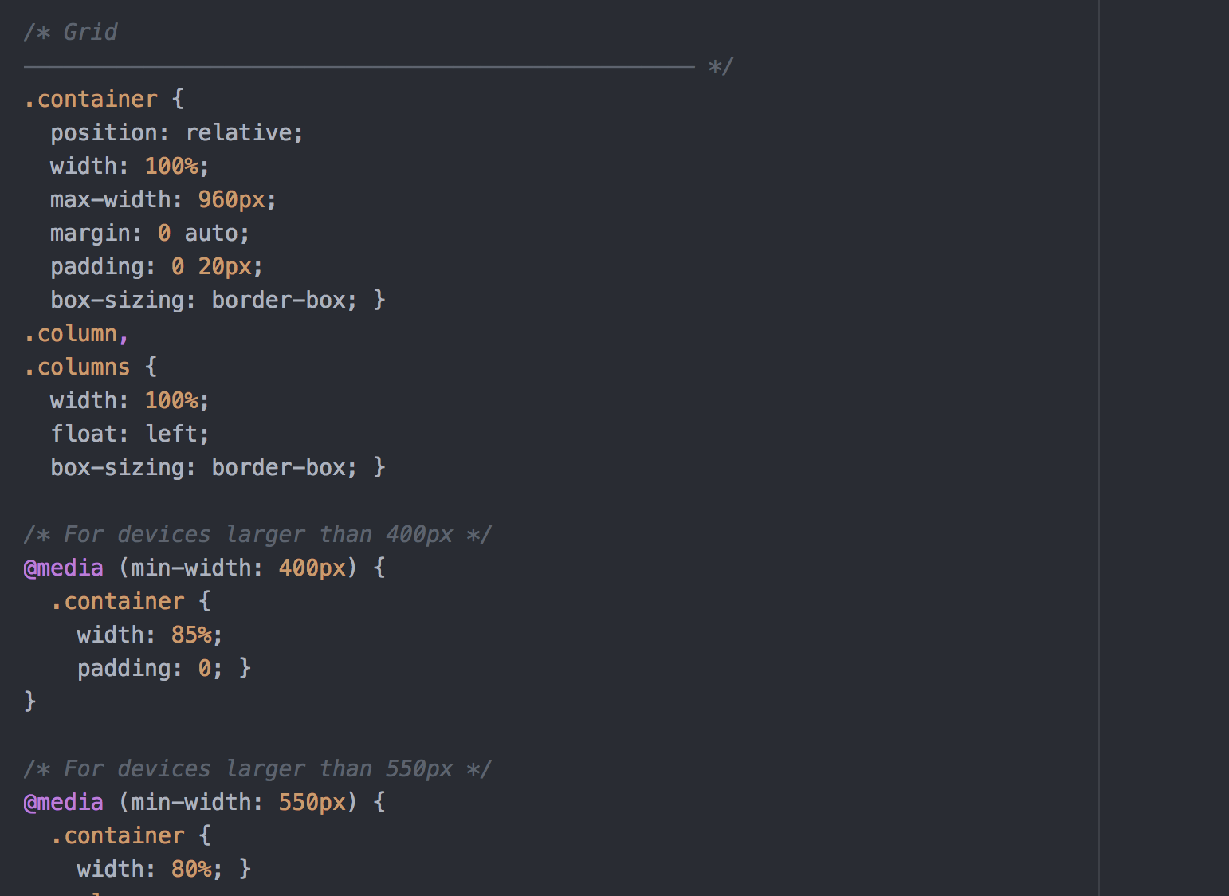
skeleton.css

Slide 12
Combining classes
<div class = “container”>
<div class = “column>
        ……….

Slide 13

Combining classes
div class = “column alpha”>
……….

Slide 14
Combining classes
<div class = “container”>
<div class = “one column>
        ……….

Slide 15
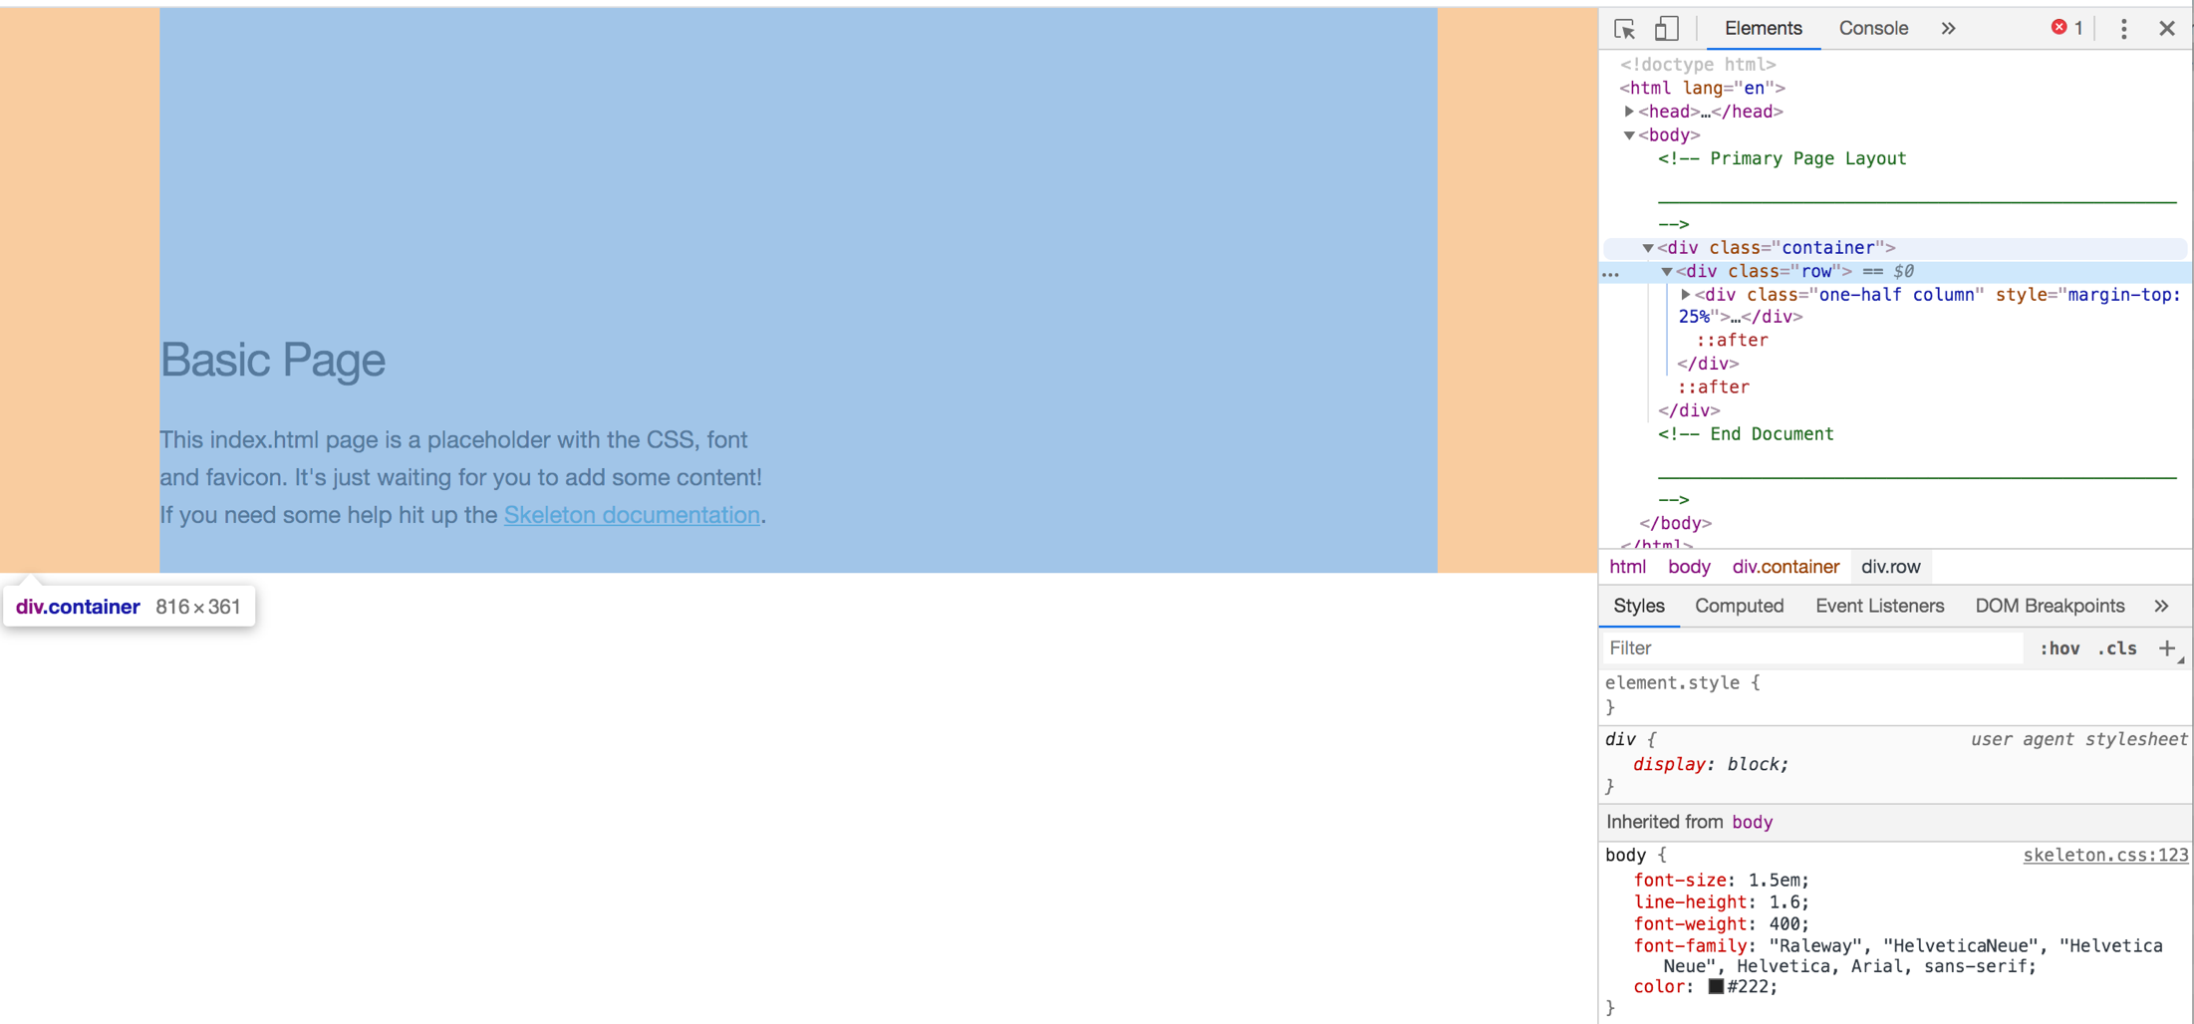
Skeleton
<div class = “container”>
Principles

Slide 16
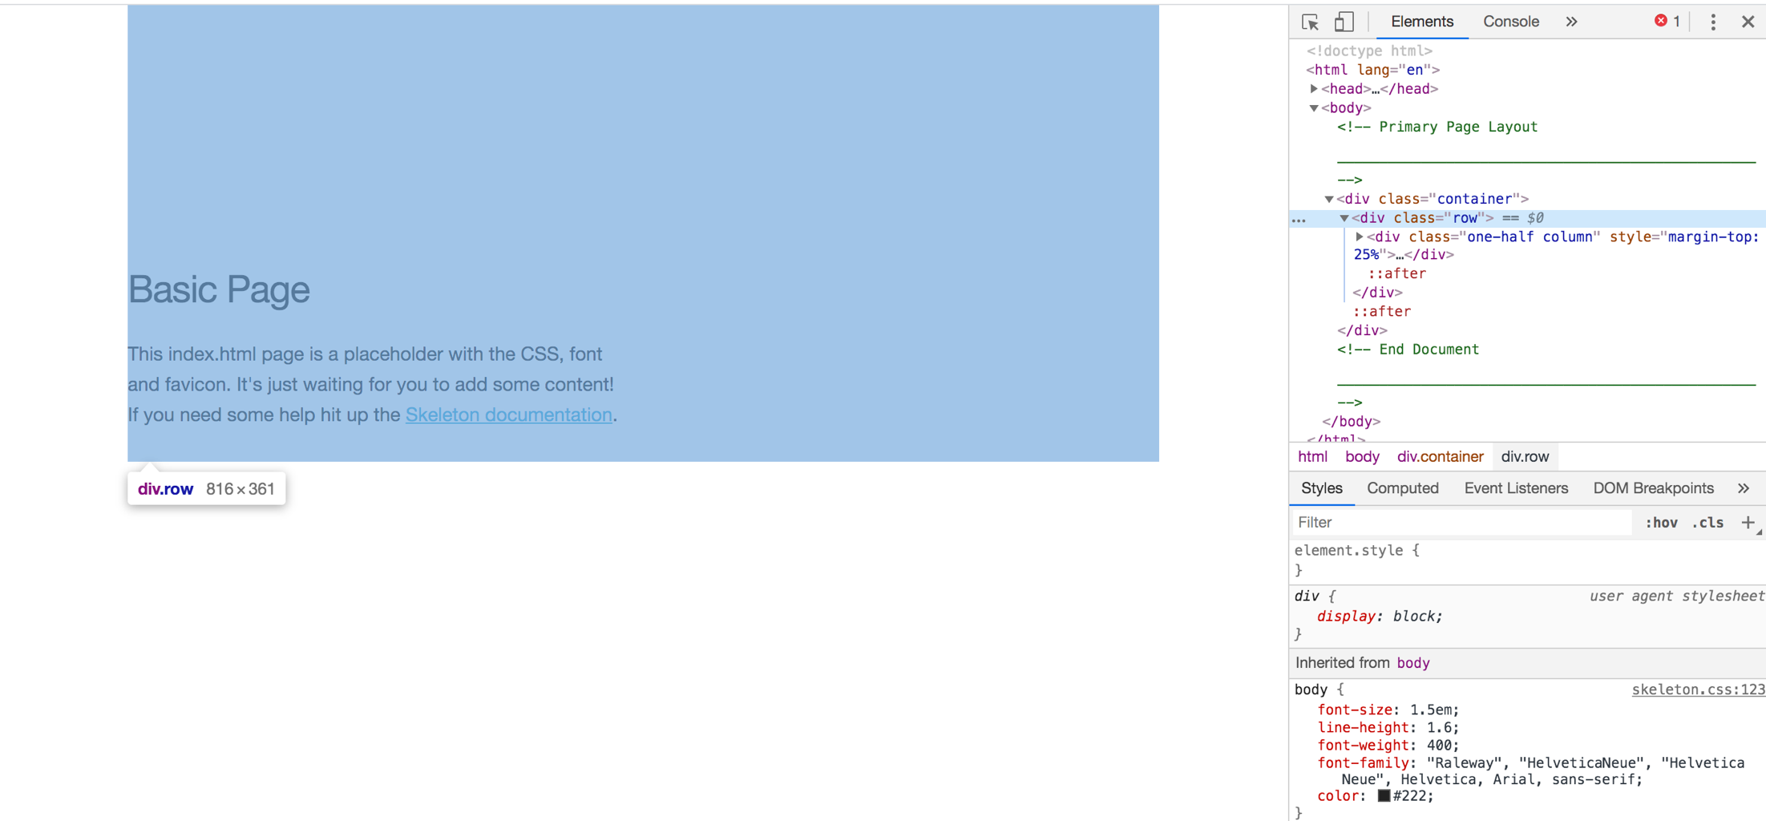
Skeleton
<div class = “row”>
Principles

Slide 17
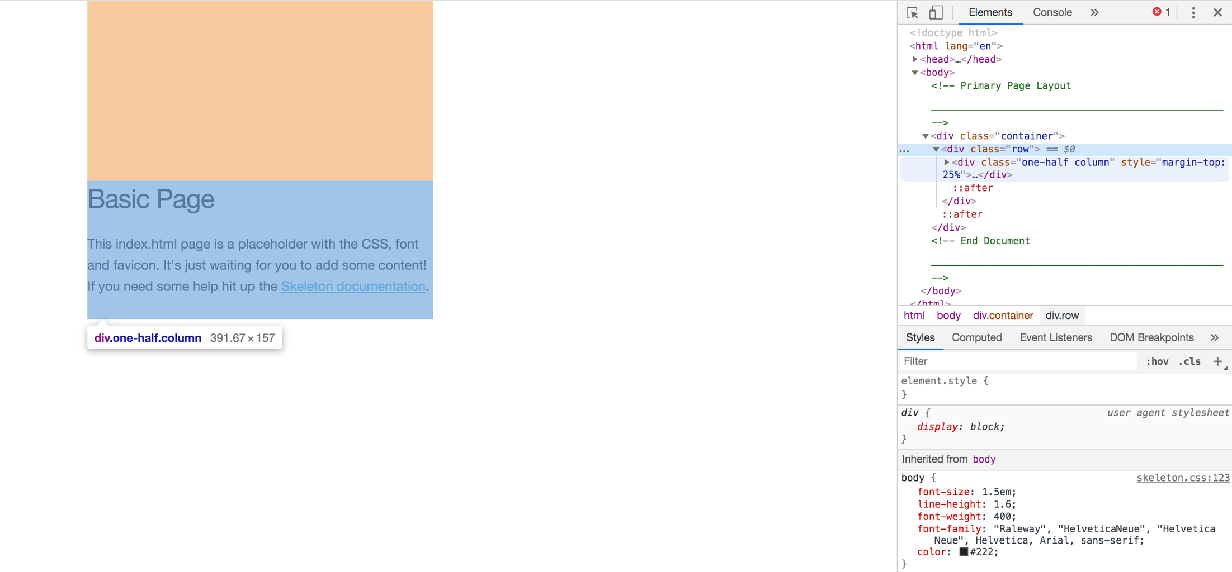
Skeleton
<div class = “one-half column”>
Principles

Slide 18
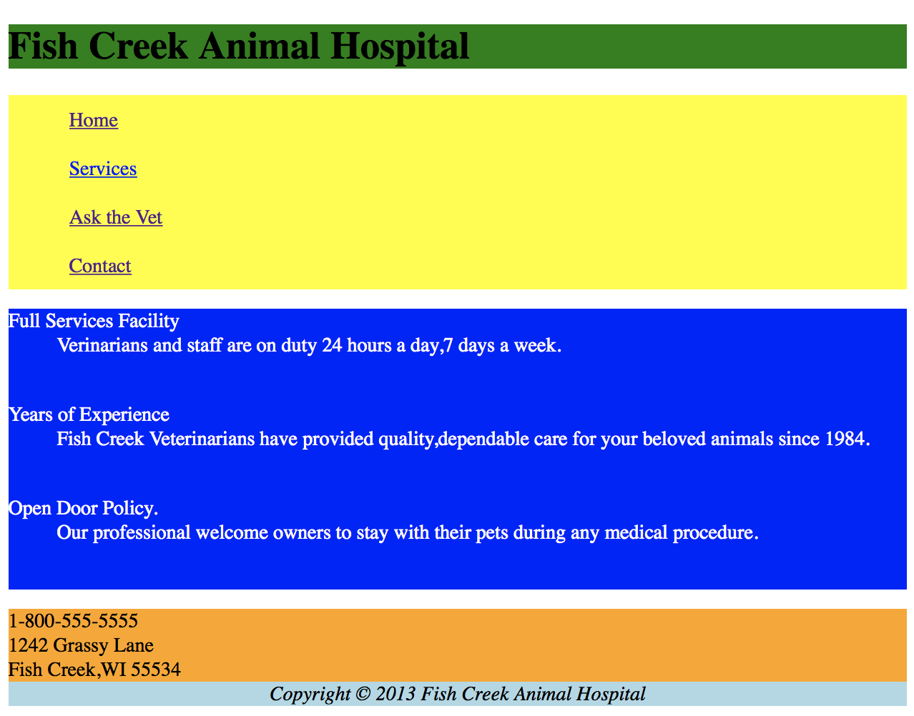
Use Skeleton to structure Fish Creek
Principles

